Slide 1
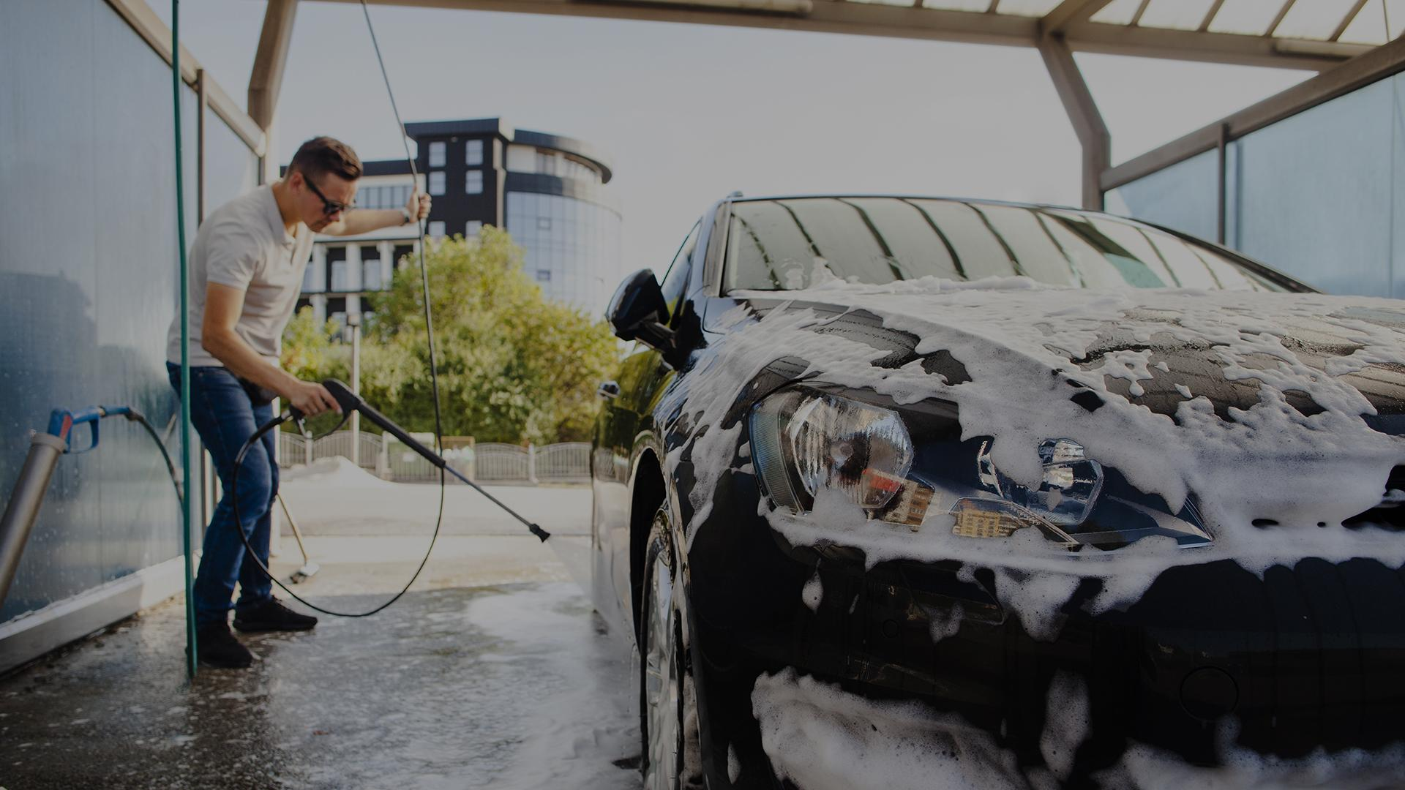
PRELIMINARY PRESENTATION
Supervisor : Ms. S. Thrimahavithana
Co-supervisor: Mr. Roshan Abeyweera
SCS 2202

Slide 2
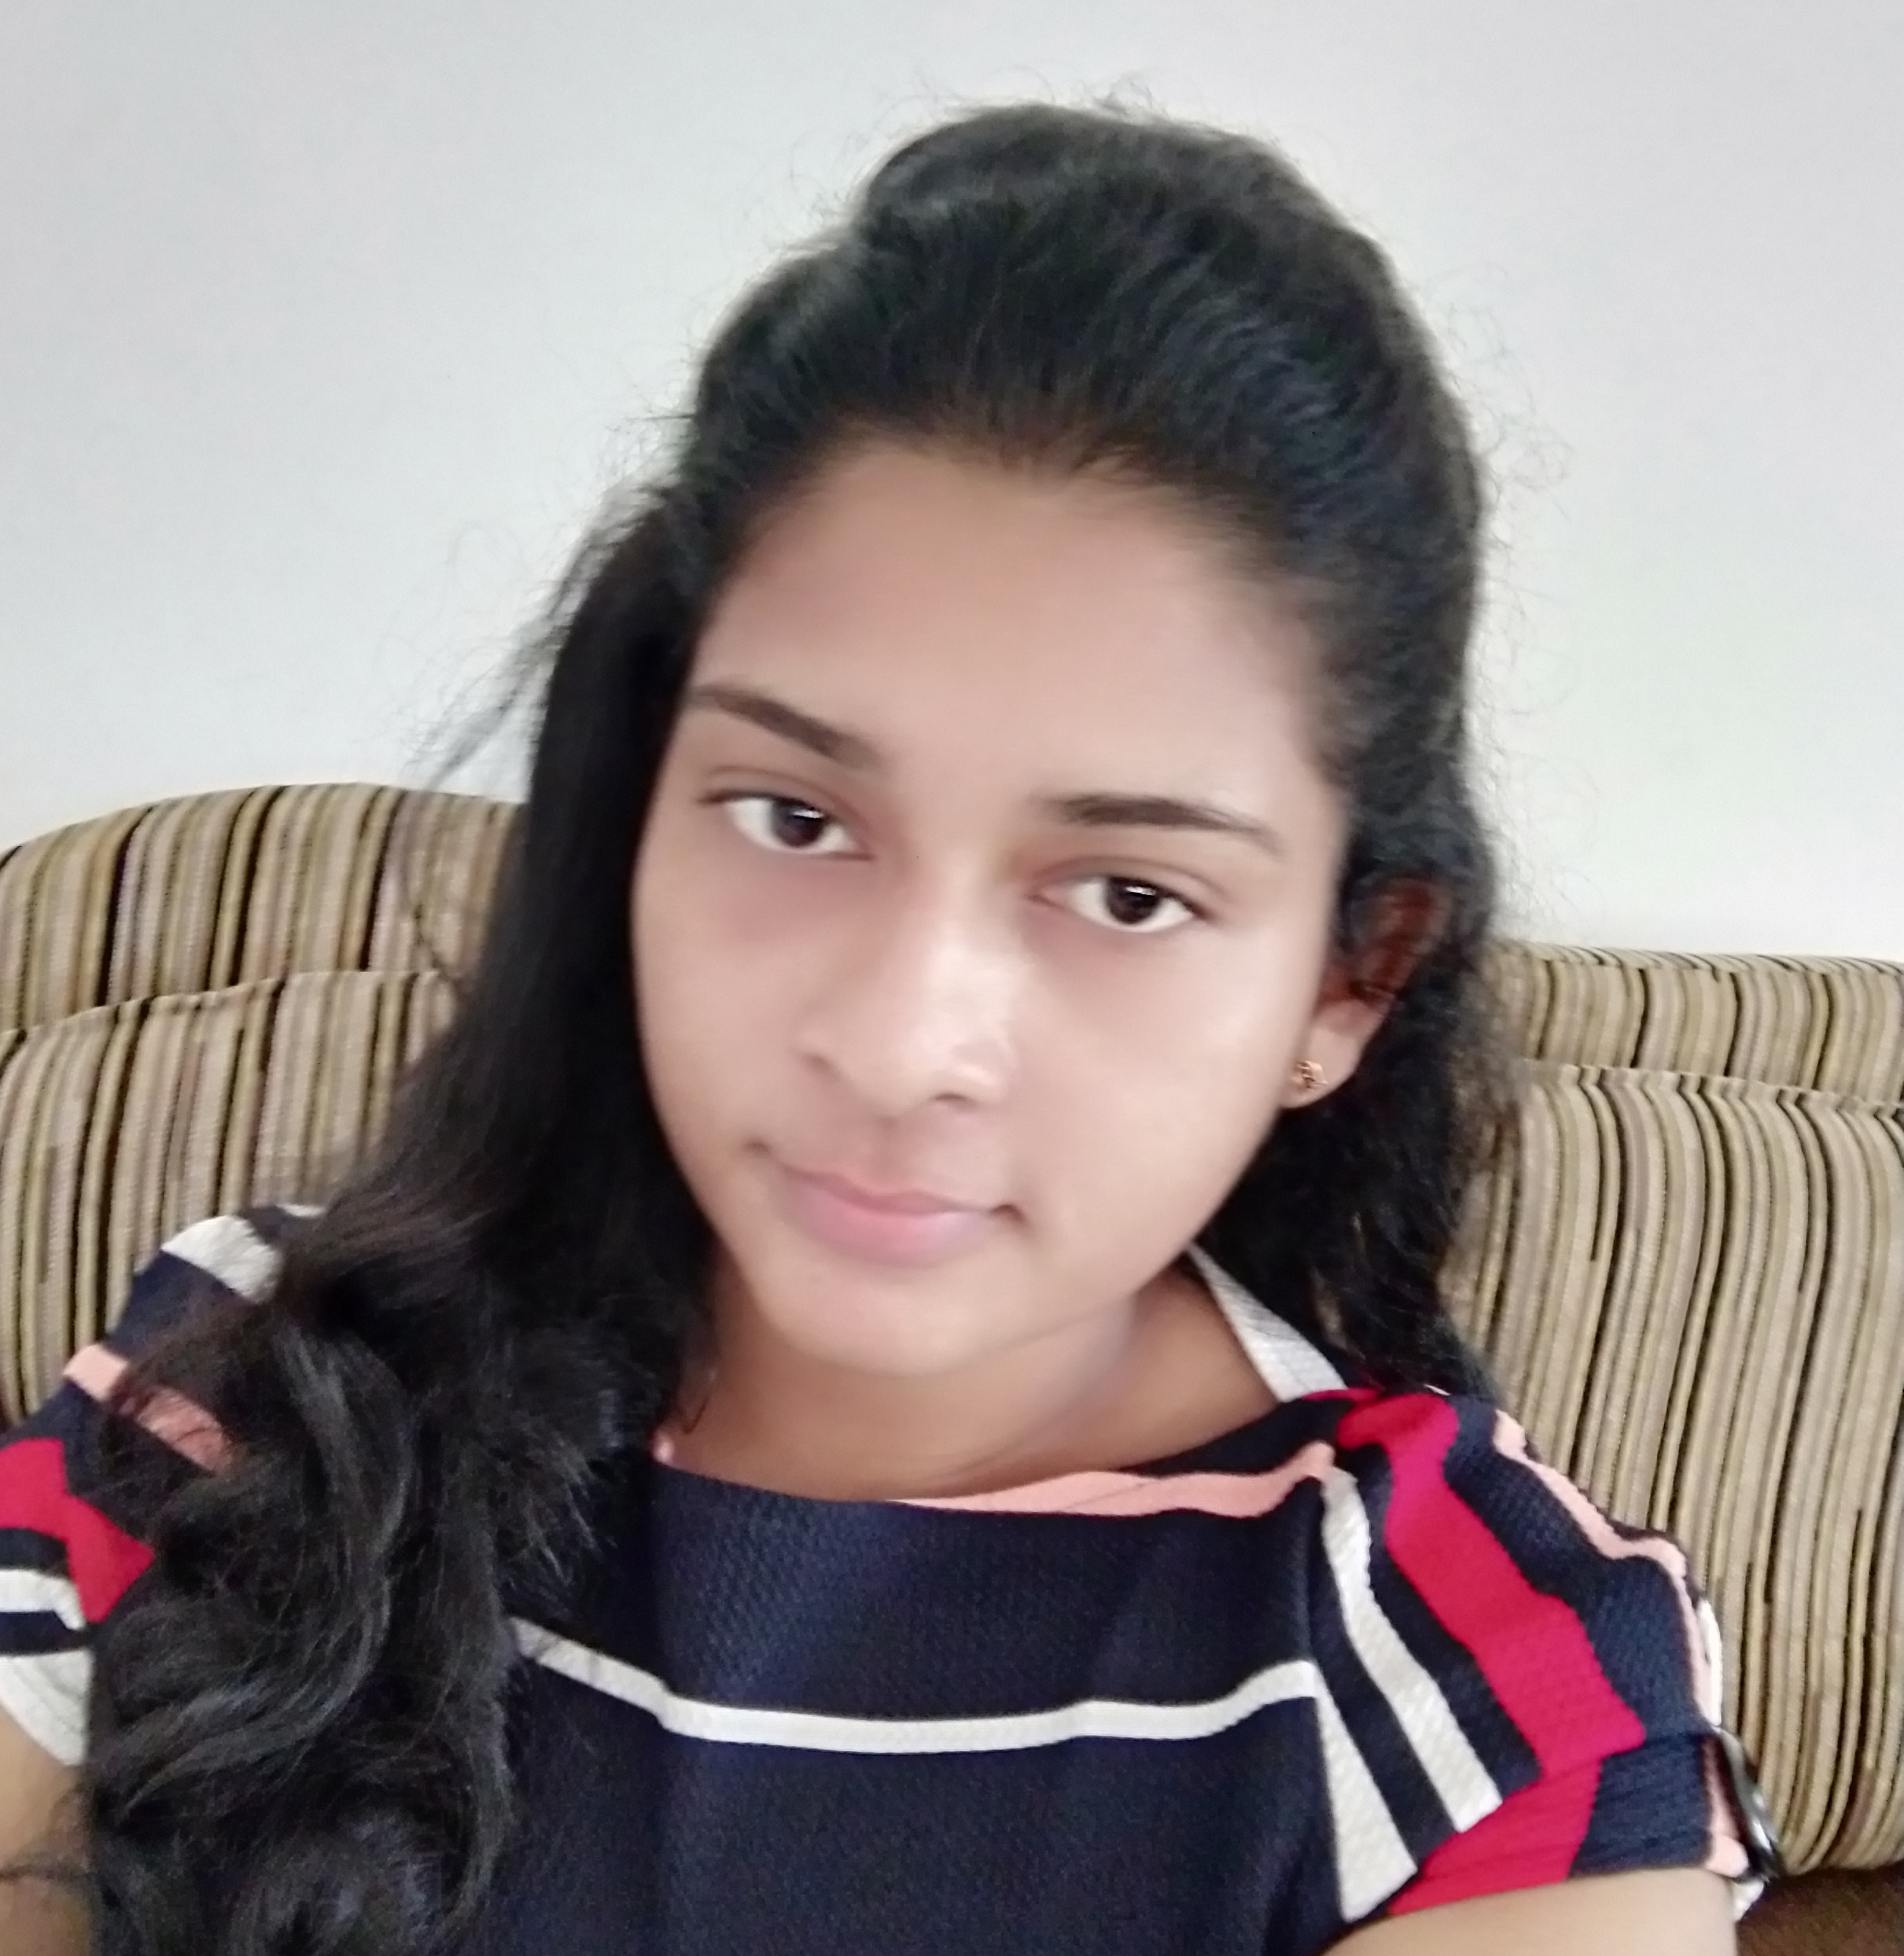

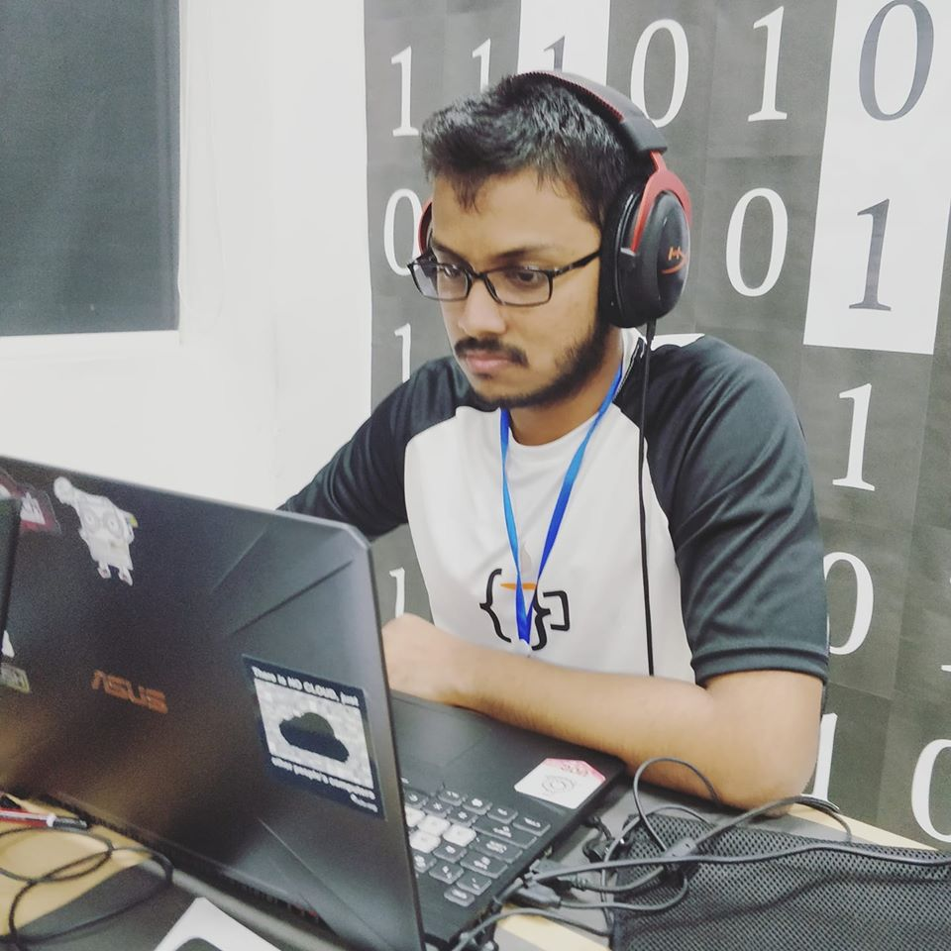

Team CS 37
W.M.D.M.Y. Wickramanayaka
T.W.T. Dulshan
U.W.T.O Weerasinghe
W.K.B.K. Madhushanka
2018/CS/192
2018/CS/048
2018/CS/191
2018/CS/096

Slide 3
TABLE OF CONTENTS
01
02
03
04
05
06
PROBLEM DEFINITION
REQUIREMENT ANALYSIS
FEASIBILITY STUDY
LIMITATIONS & CONSTRAINTS
TECHNOLOGIES
WORKLOAD DISTRIBUTION

Slide 4
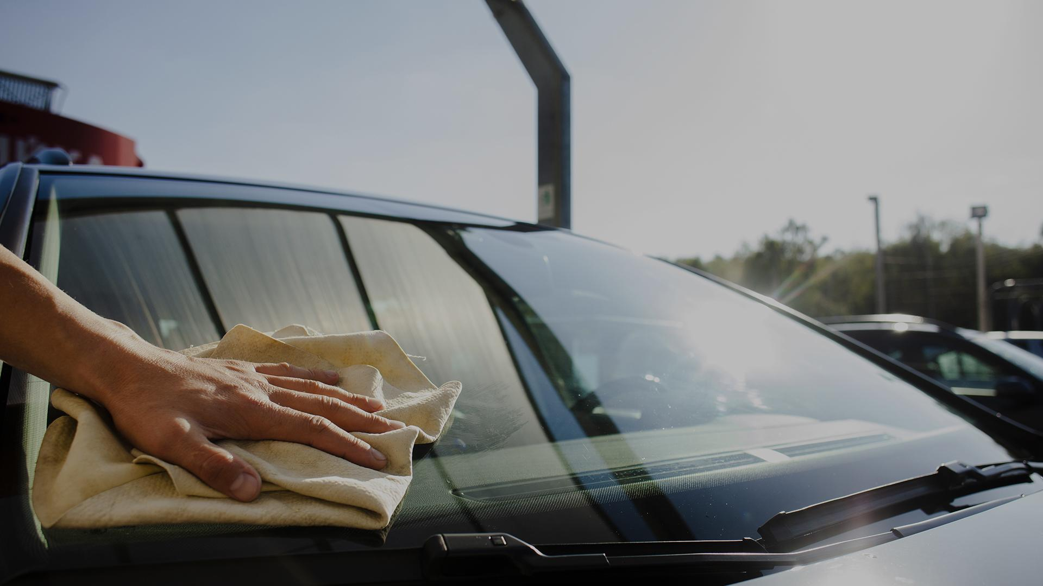
PROJECT GOAL
To produce a fully functioning, user friendly system to operate in a car service station that helps users solve the current problems in service stations whilst helping to maximize the efficiency of the business by saving the customers time.

Slide 5
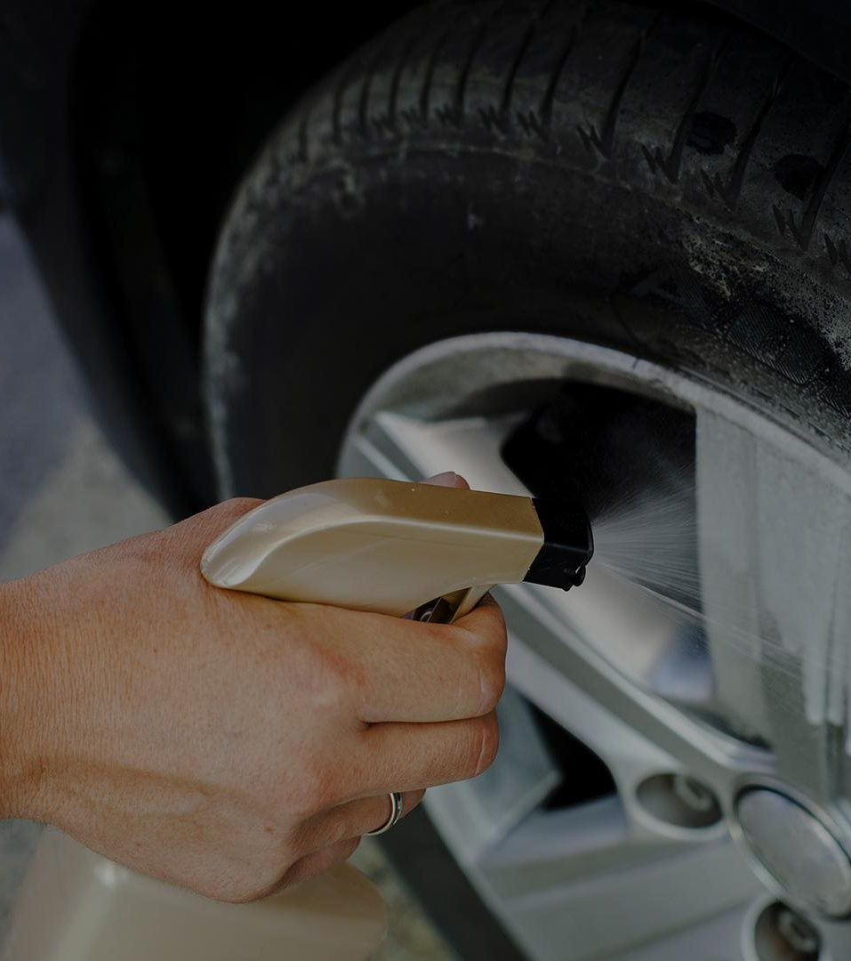
01
PROBLEM DEFINITION

Slide 6
How many times have you wasted more than 1 hour at a service station?
Just to get your turn?

Slide 7

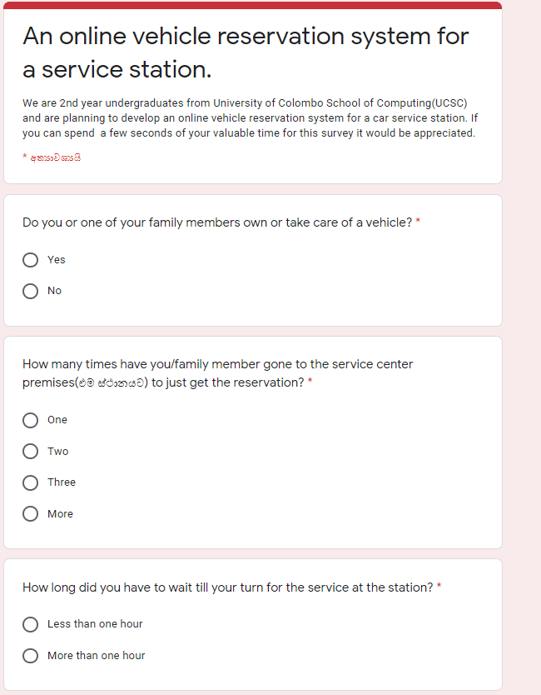
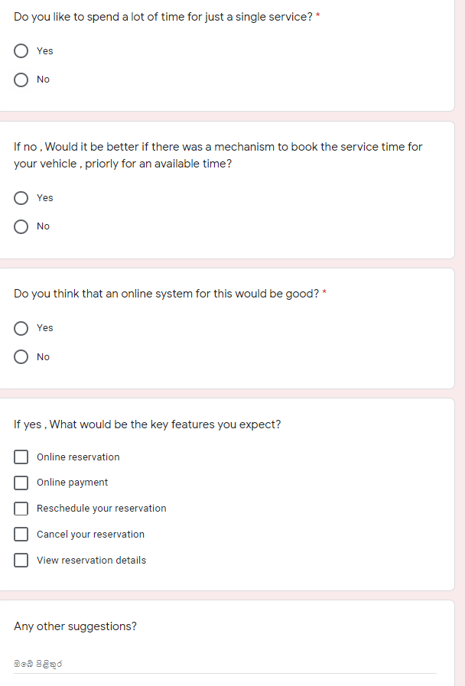

Slide 8
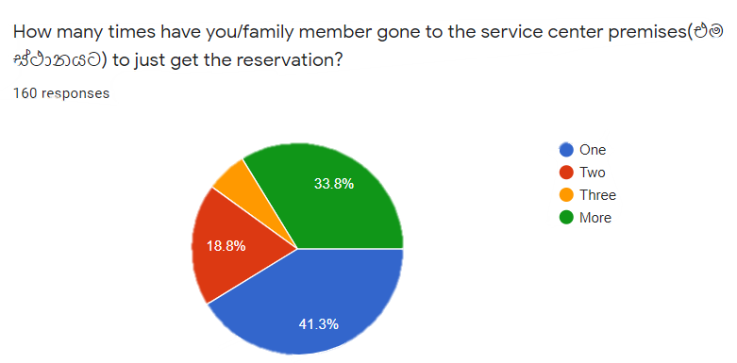
Survey

Slide 9
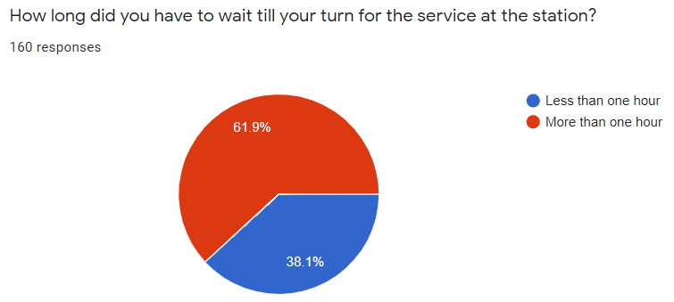

Slide 10

SERVICE CUSTOMER
Long queues and uncertainty of number of vehicles at service stations
Inability to know vacancy of time slots in advance
No reservation system to book online

Slide 11
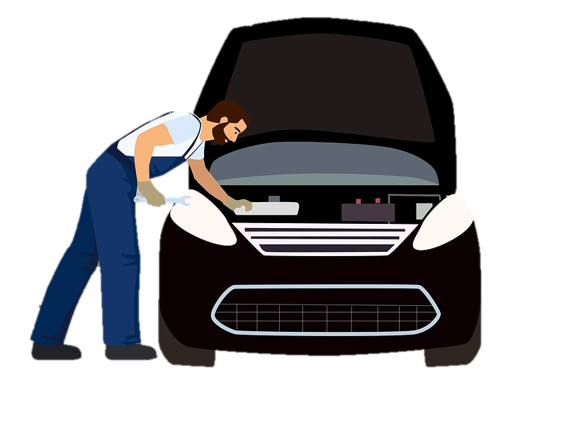
EMPLOYEE
Necessity to physically meet a superior officer to request leave
Not being able to keep track of number of leaves taken , number of leaves left

Slide 12

CAR SERVICE MANAGER
Necessity to physically meet workers and clarify to accept/reject leave
No central database on the following data to take managerial decisions:
Employee leave taking
Online reservations
Reservation cancellations
Most type of reservation taken

Slide 13

02
Requirement Analysis

Slide 14
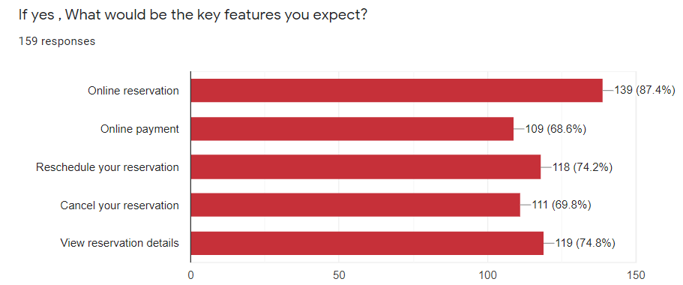

Slide 15
User identification
Vehicle service customers
Manager
(Admin)
System handler
(Receptionist)
Employees

Slide 16
SERVICE CUSTOMER
Login and authentication
Separate logins for all user types & their accounts (Customer, Employee, Manager)
Relevant information for each user will be stored
Encrypted login details
Password recovery options
Online reservation system
Reservation through smart calendar after logging in
Cancel / Update reservation based on condition
Publicly display the available time slots in smart calendar
Online payment System
Payment for reservation through gateway
Authentication and safe encryption

Slide 17
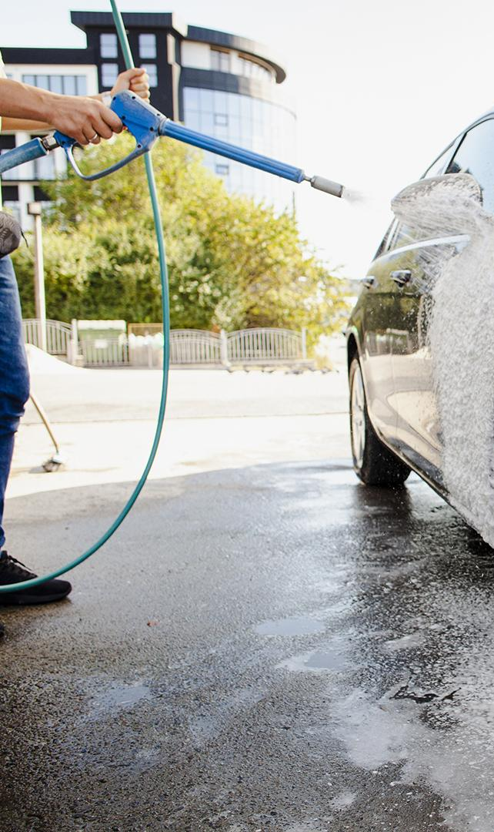
SERVICE EMPLOYEE
Employee leave management system
Apply leave through smart calendar
Can cancel before conditional date
Manager can accept/reject
View summary of leaves taken during a month

Slide 18
SERVICE MANAGER
Generate reports
Can view summary of following
Employee leaves
Reservations per service type
Number of Cancelled reservations
Accept /Reject employee leaves

Slide 19
Quality Attributes
USER-FRIENDLINESS
RELIABILITY
USABILITY
MODIFIABILITY
SECURITY
TESTABILITY

Slide 20
Quality Attributes
User-friendliness-
Easily accessible since it is a website
User friendly interfaces
Reliability-
Backup of databases on a given basis, so data loss will not occur
Online payment through secure channel
Usability -
System will be optimized to give best resolution across different devices
(Desktops, Laptops, Mobile devices)

Slide 21
Modifiability- Component by component integration. Future enhancements can be attached modularly (salary calculation, inventory management ) Security- Authentication using user accounts All login details are sent encrypted Testability- Since system is modular each component can be tested separately Debugging is easier
Non-functional requirements

Slide 22



SIMILAR SYSTEMS
 | Online Reservation | View vacant time slots online | Leave Management of employees | Online advanced payment

Slide 23


For all this…
Online Reservation
View vacant time slot online
Leave Management of employees
Online advance payment
A simple web application reservation system + leave managing system for car service stations

Slide 24
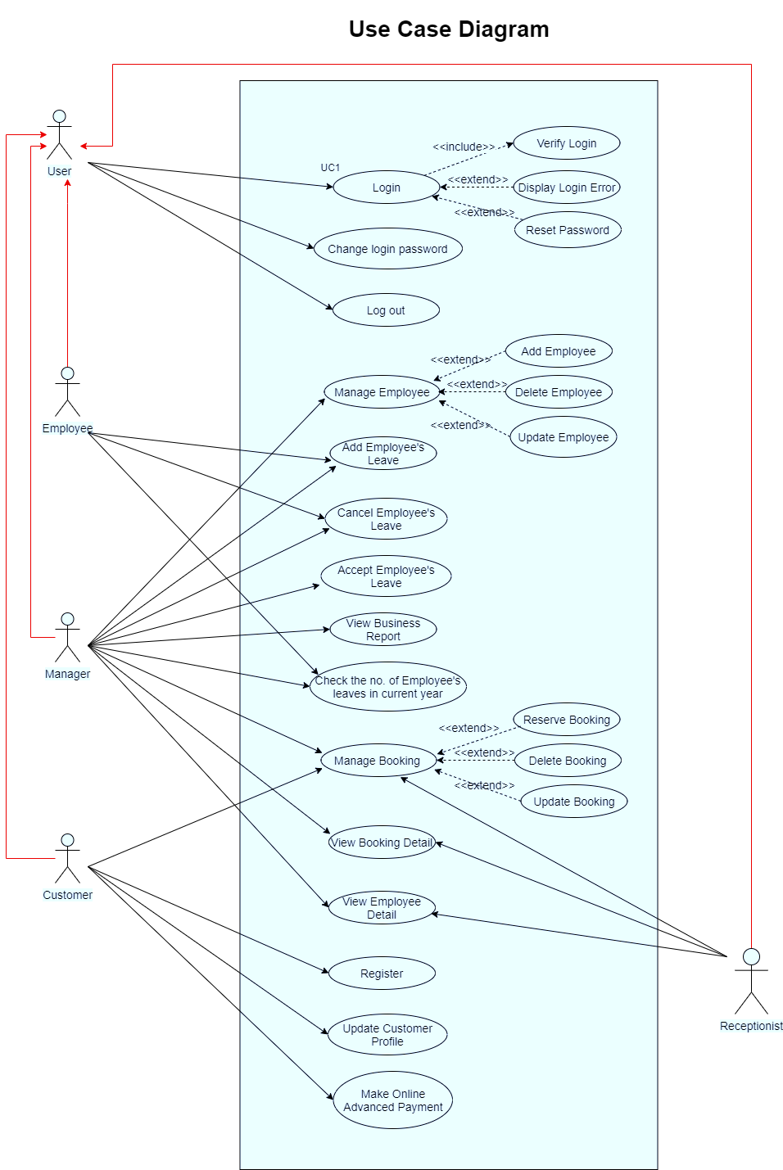
Use case diagram

Slide 25
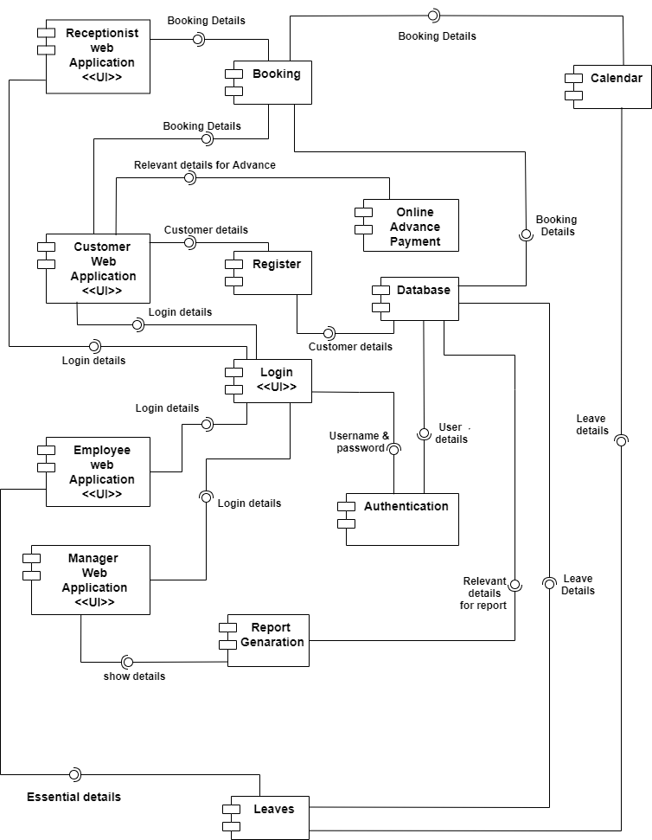
Component diagram (high level architecture)

Slide 26

03
Feasibility Study

Slide 27
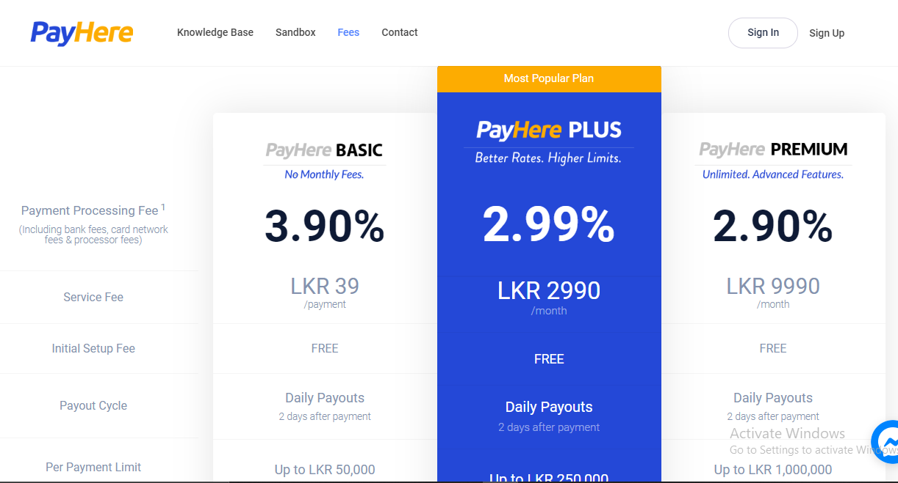
Economical feasibility:
Main costs of the proposed system
Cost for PayHere sandbox module - LKR 39 /payment
Notes:
Only missing slide

Slide 28
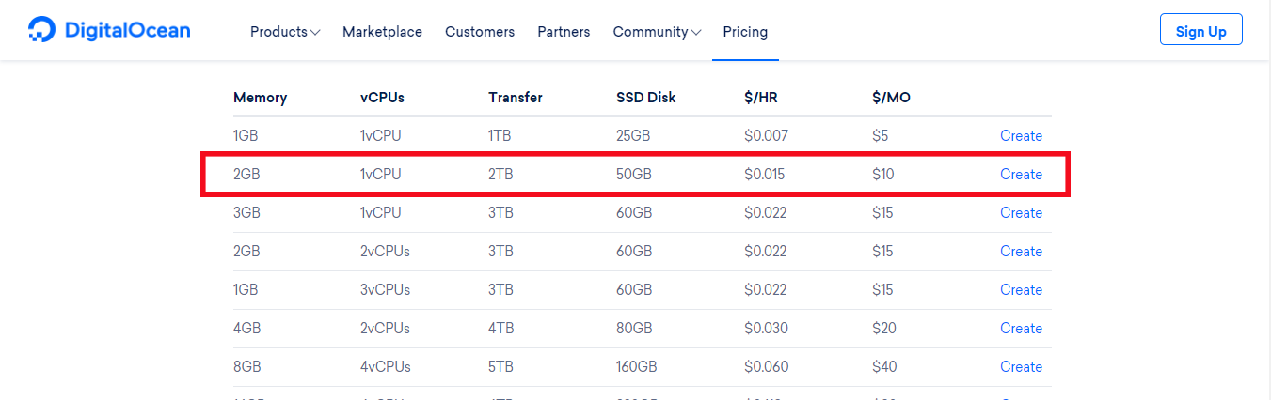
Economical feasibility:
Cost for hosting:
- Digital Ocean Web server: monthly - $10
Notes:
Only missing slide

Slide 29
Economical feasibility:
Other costs:
Cost for communication
- Distant communication via mobile phones and zoom meetings
No cost for software
- Free and Open Source Software
No additional hardware cost
- Own routers and internet plans will be used.

Slide 30
Technical Feasibility
The required technical knowledge of the development team is at a satisfied level
Required technology is freely available
All above mentioned resources are easily usable within our knowledge limits. Hence the project is technically feasible.

Slide 31
Operational Feasibility
To use the system,
Manager, system handler(receptionist) should have medium knowledge in IT and English
A Personal Computer with a 24x7 internet connection
Employees with a basic knowledge of IT
Because there will be no need of getting additional training or HR resources, the project is operationally feasible.

Slide 32
Scheduling feasibility
Requirement Analysis
Feasibility Study
System Design
Implementation
Testing
Waterfall model
Deployment
Notes:
Need to graphically improve the waterfall model

Slide 33
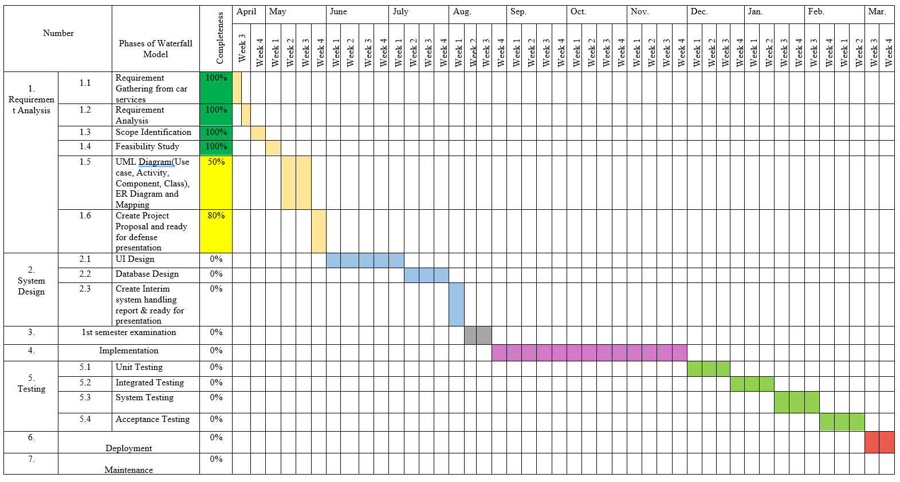

Slide 34
1232 hours
7 hours x 4 Team Members = 28 hours per week
28 hours/week * 44 weeks=
This is only a tentative timeline. Actual schedule may change due to the current situation

Slide 35
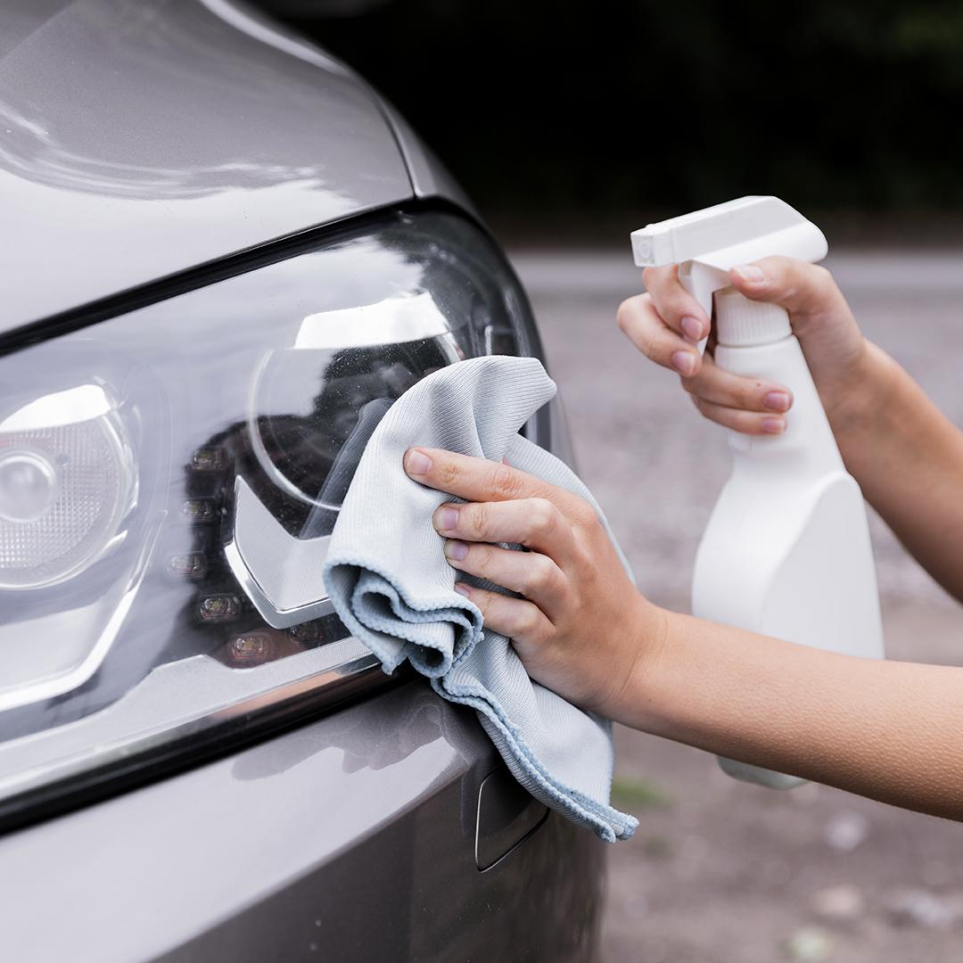
04
LIMITATIONS AND CONSTRAINTS

Slide 36

Service station will also conduct operations manually in case employees lack IT knowledge.
Salary calculation , promo code generation will not be implemented due to time constraints.
Can be added later due to modularity.

Slide 37
Technologies
05

Slide 38




Front end
Back End

Slide 39

Database

Slide 40




Modules
Collaboration tools

Slide 41


Version Controlling

Slide 42
Work division between group members
06
All work is to be divided according to the user roles of the system.
U.W.T.O Weerasinghe | -Customer functions
T.W.T.Dulshan | -Employee
W.M.D.M.Y.Wickramanayaka | -System handler (receptionist)
W.K.B.K.Madhushanka | -Manager

Slide 43
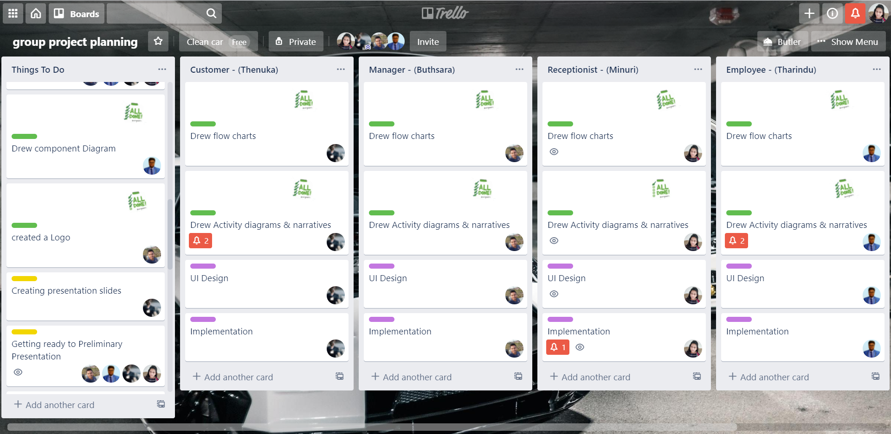
Trello board:

Slide 44
Q & A

Slide 45
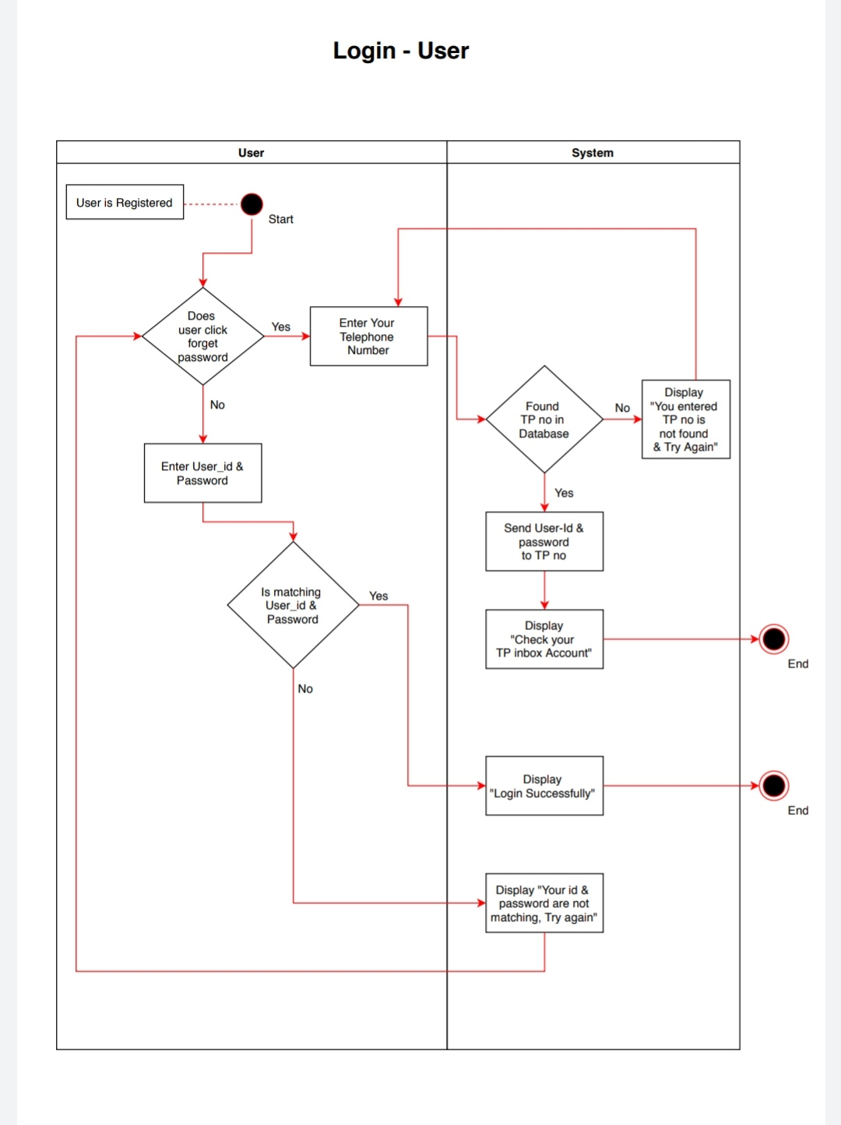
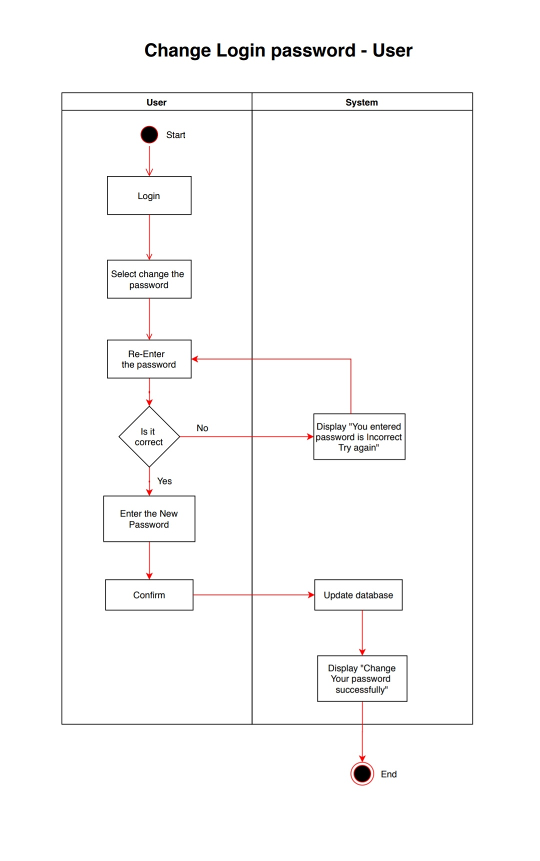

Slide 46
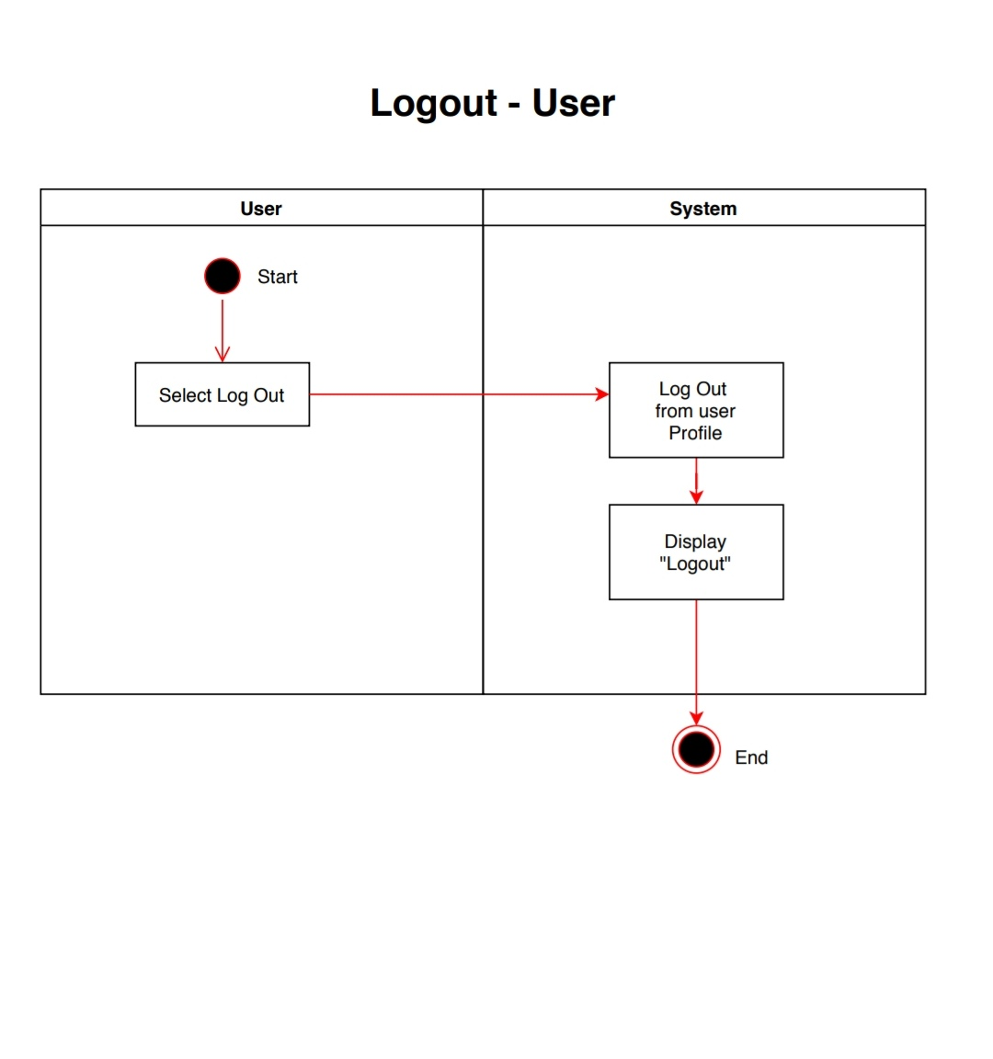
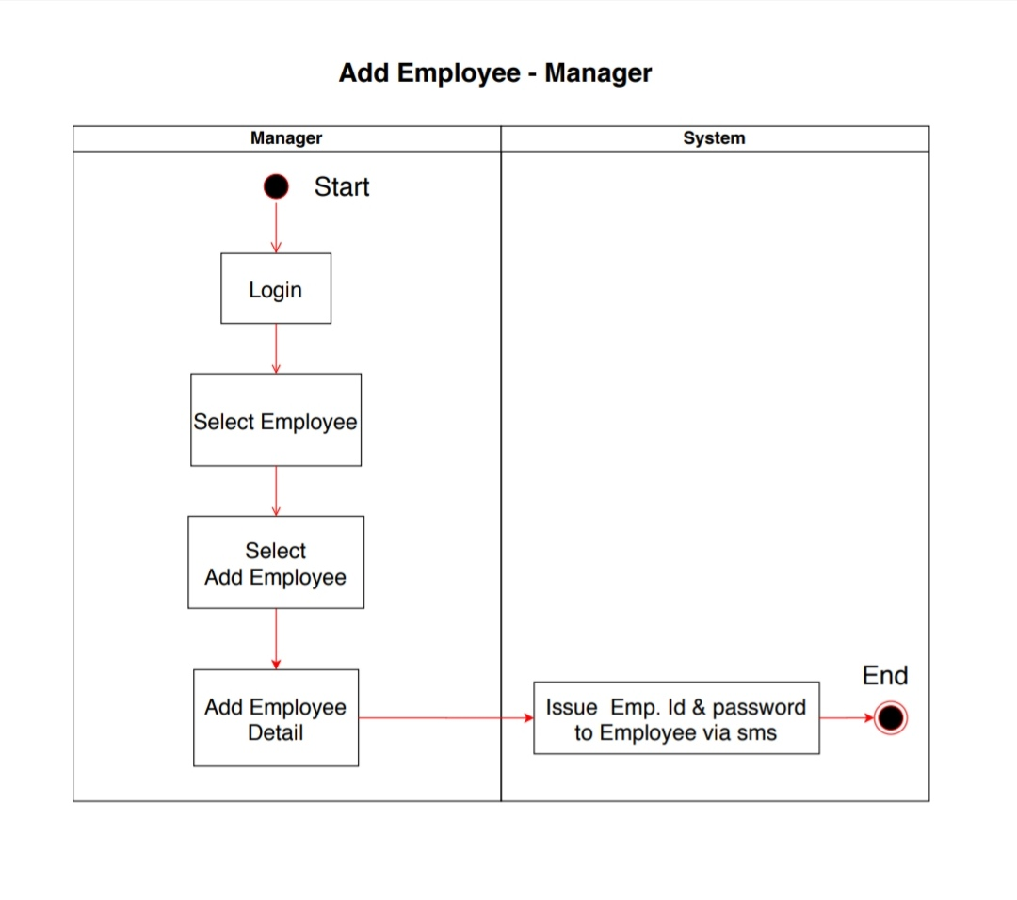

Slide 47
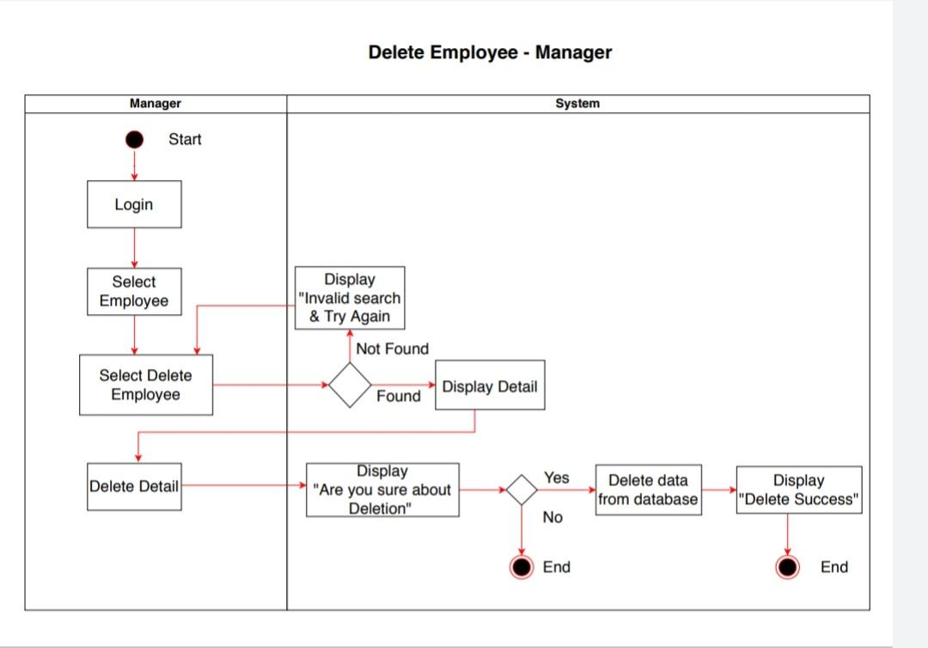

Slide 48
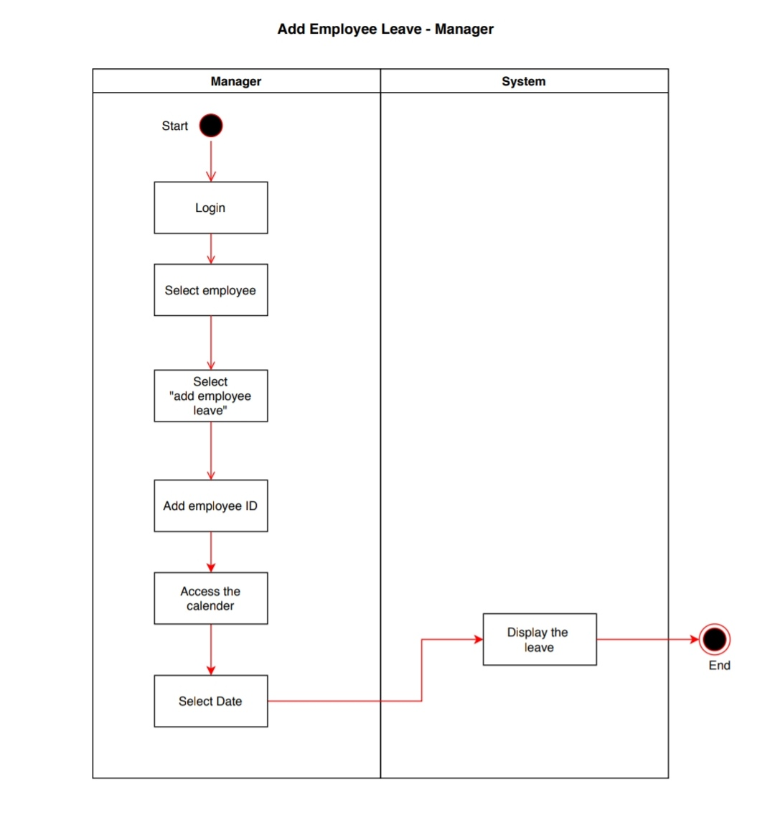
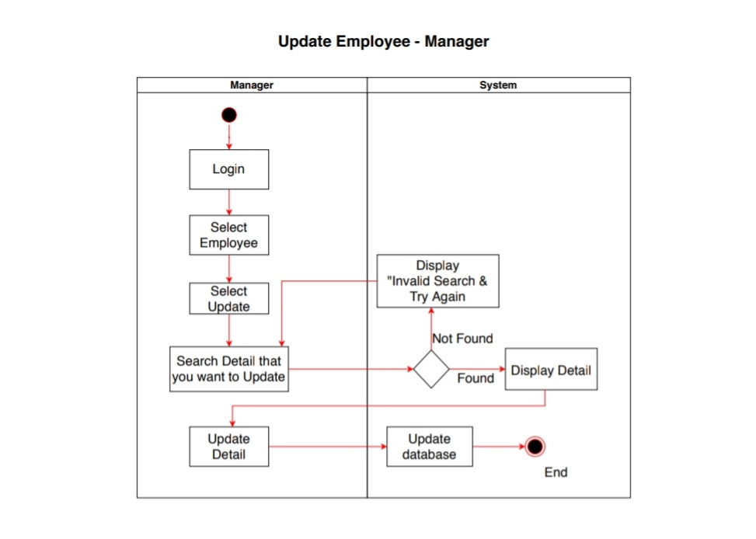

Slide 49
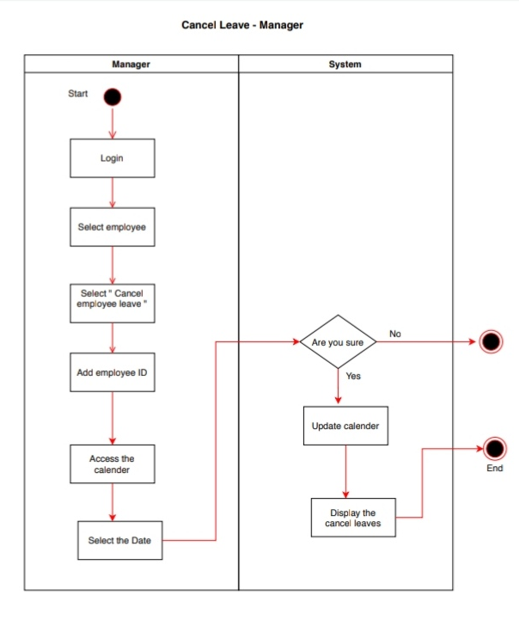
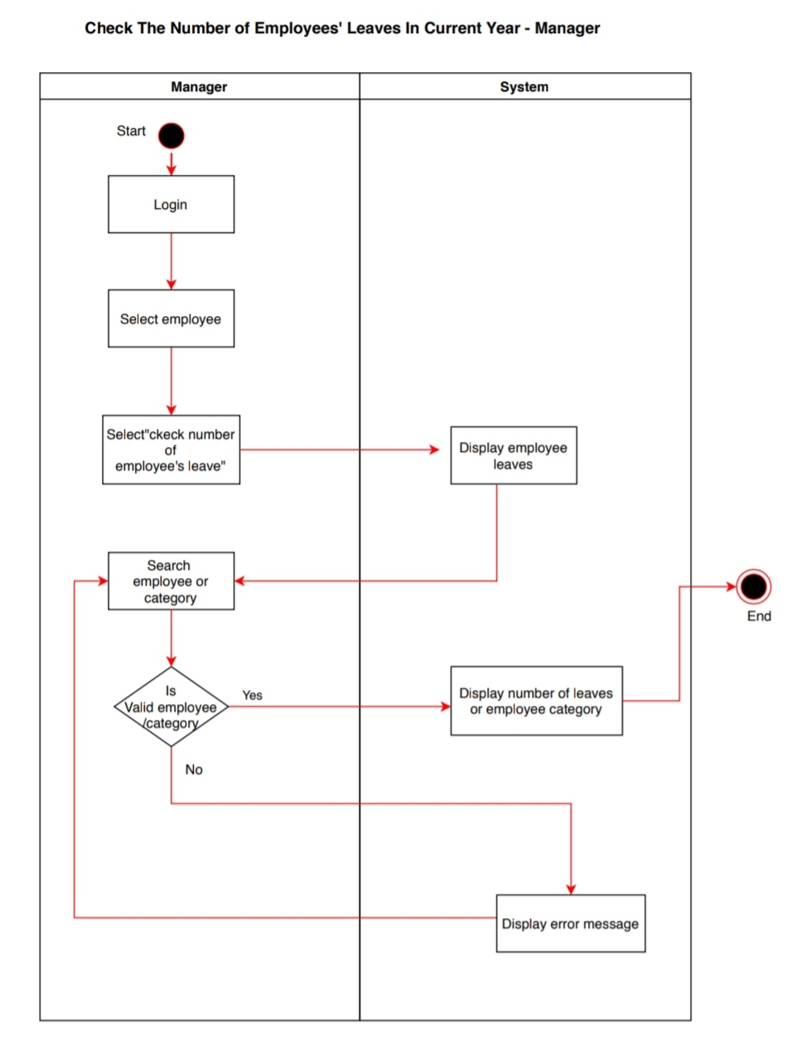

Slide 50
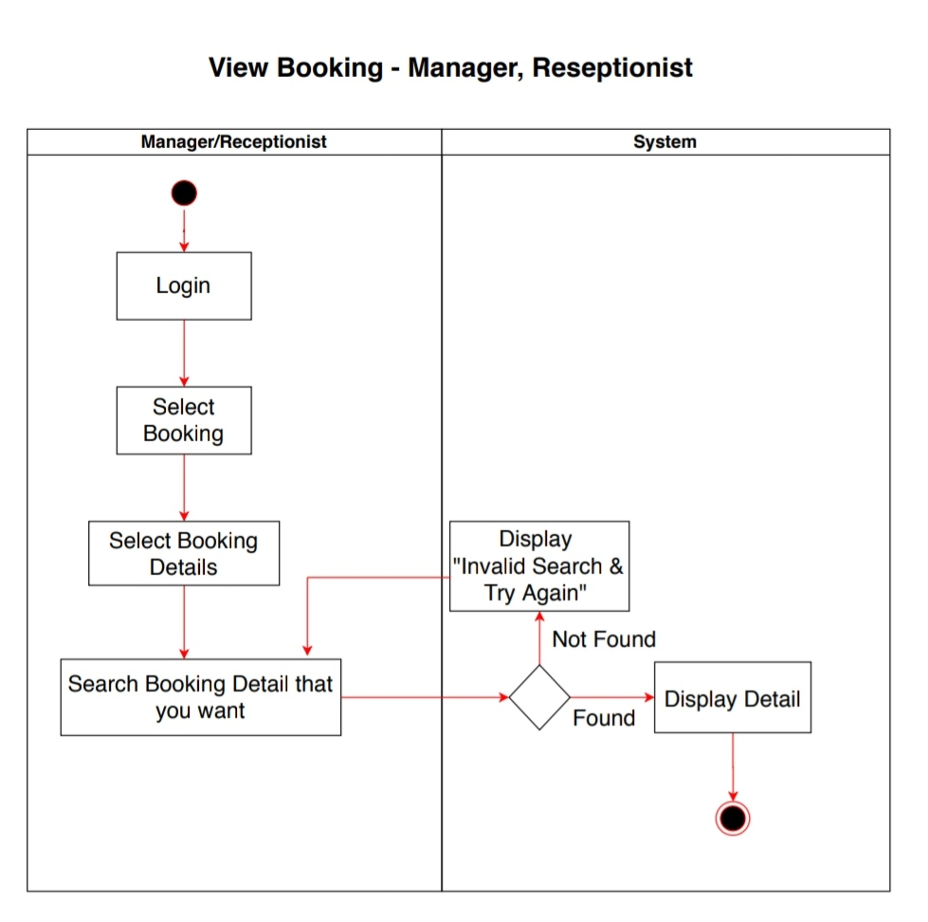
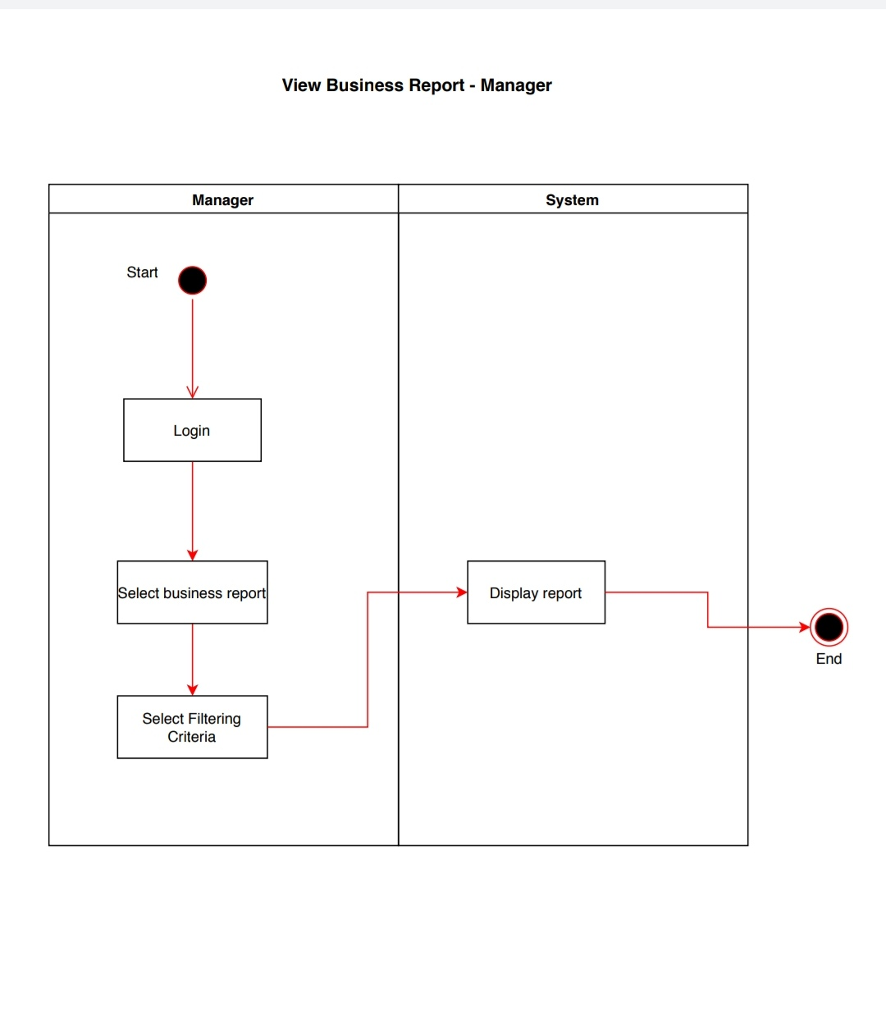

Slide 51
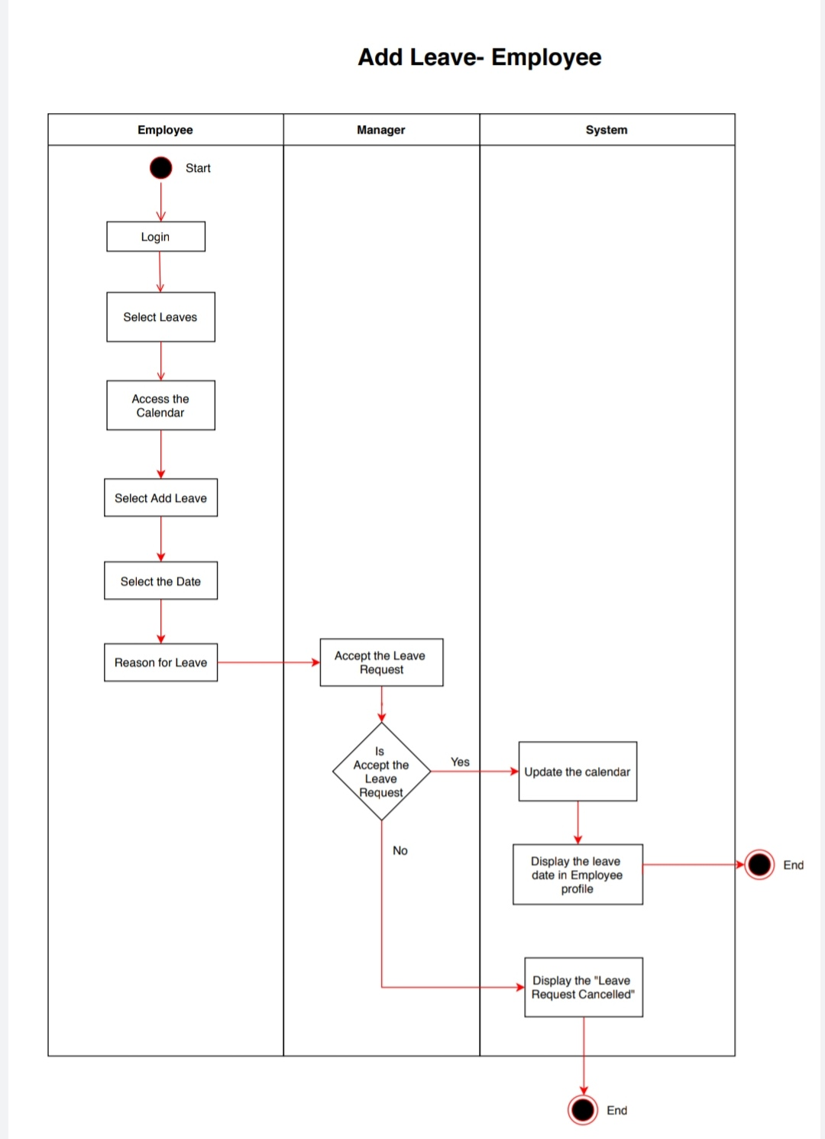
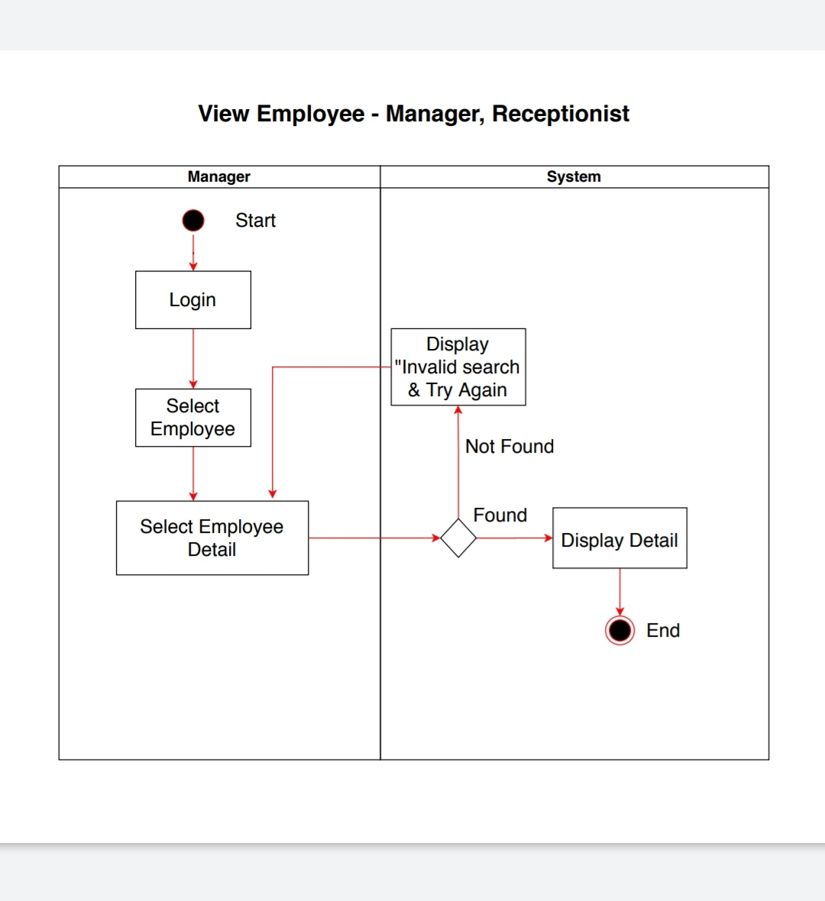

Slide 52
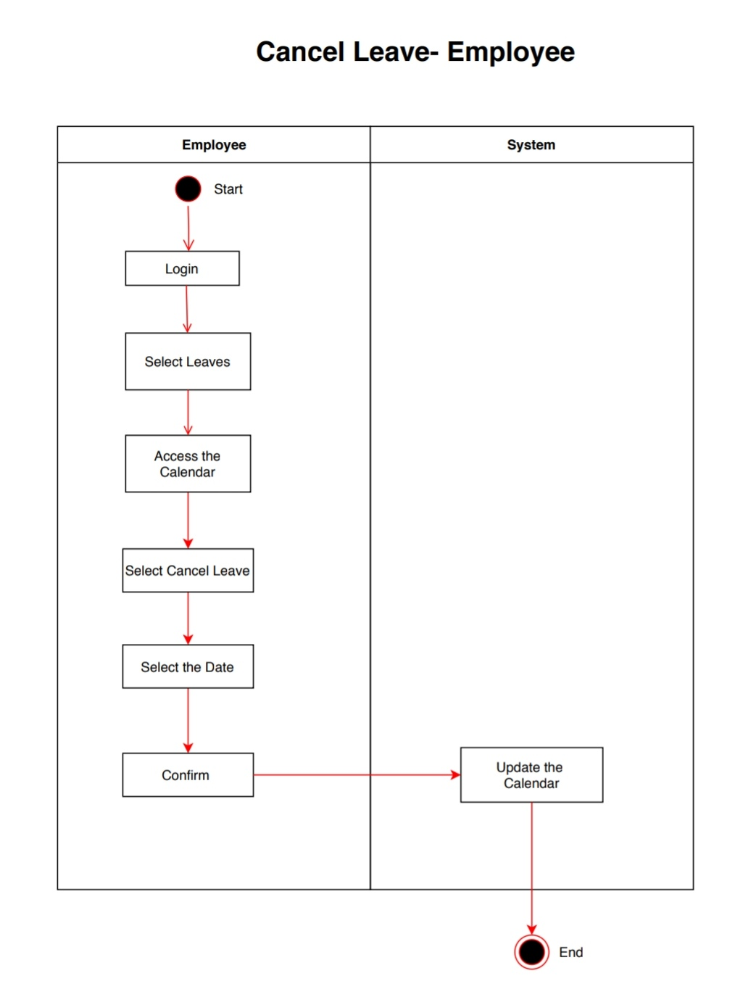
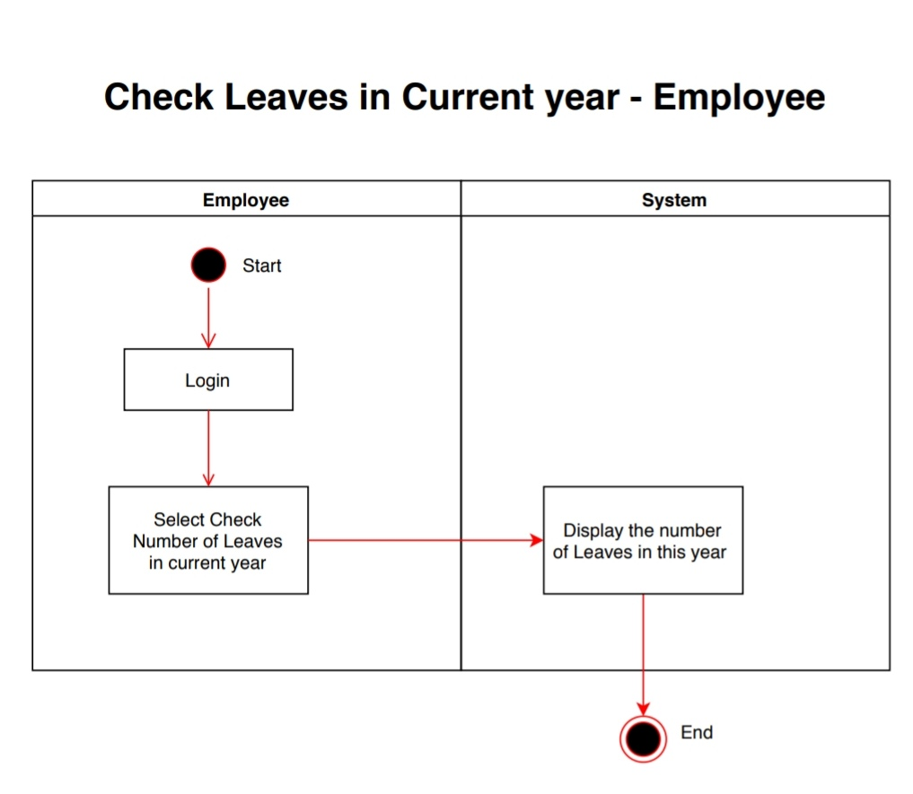

Slide 53
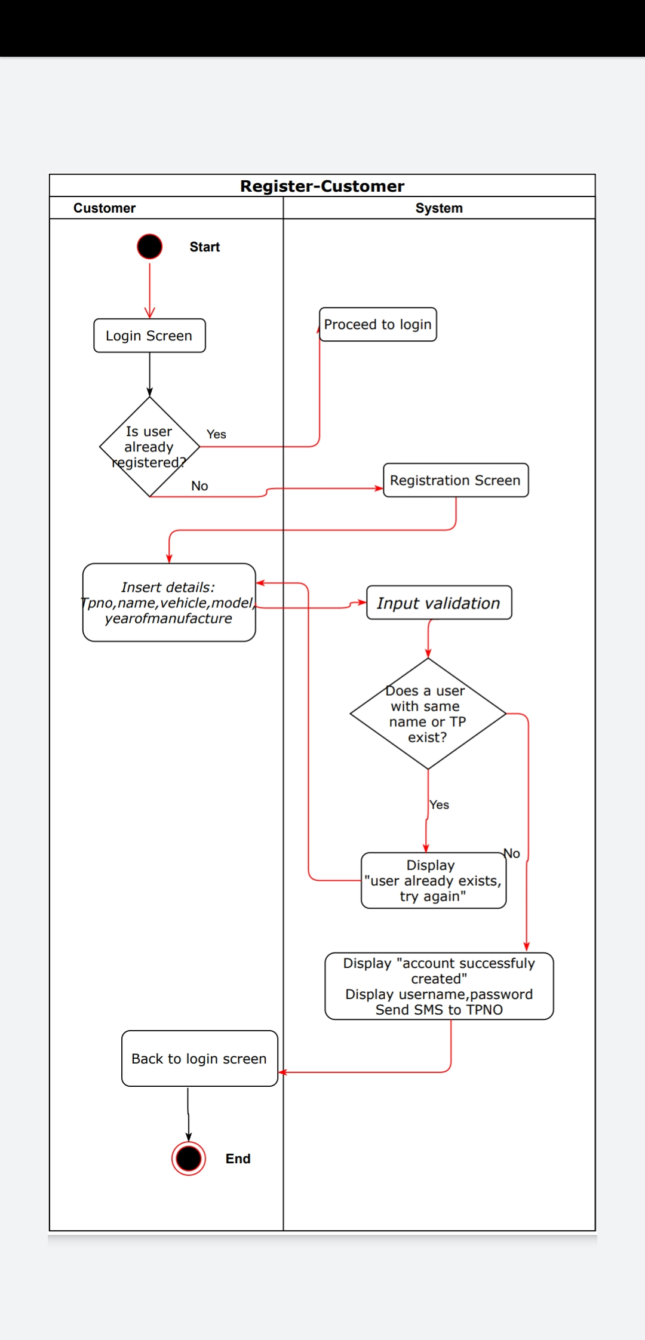
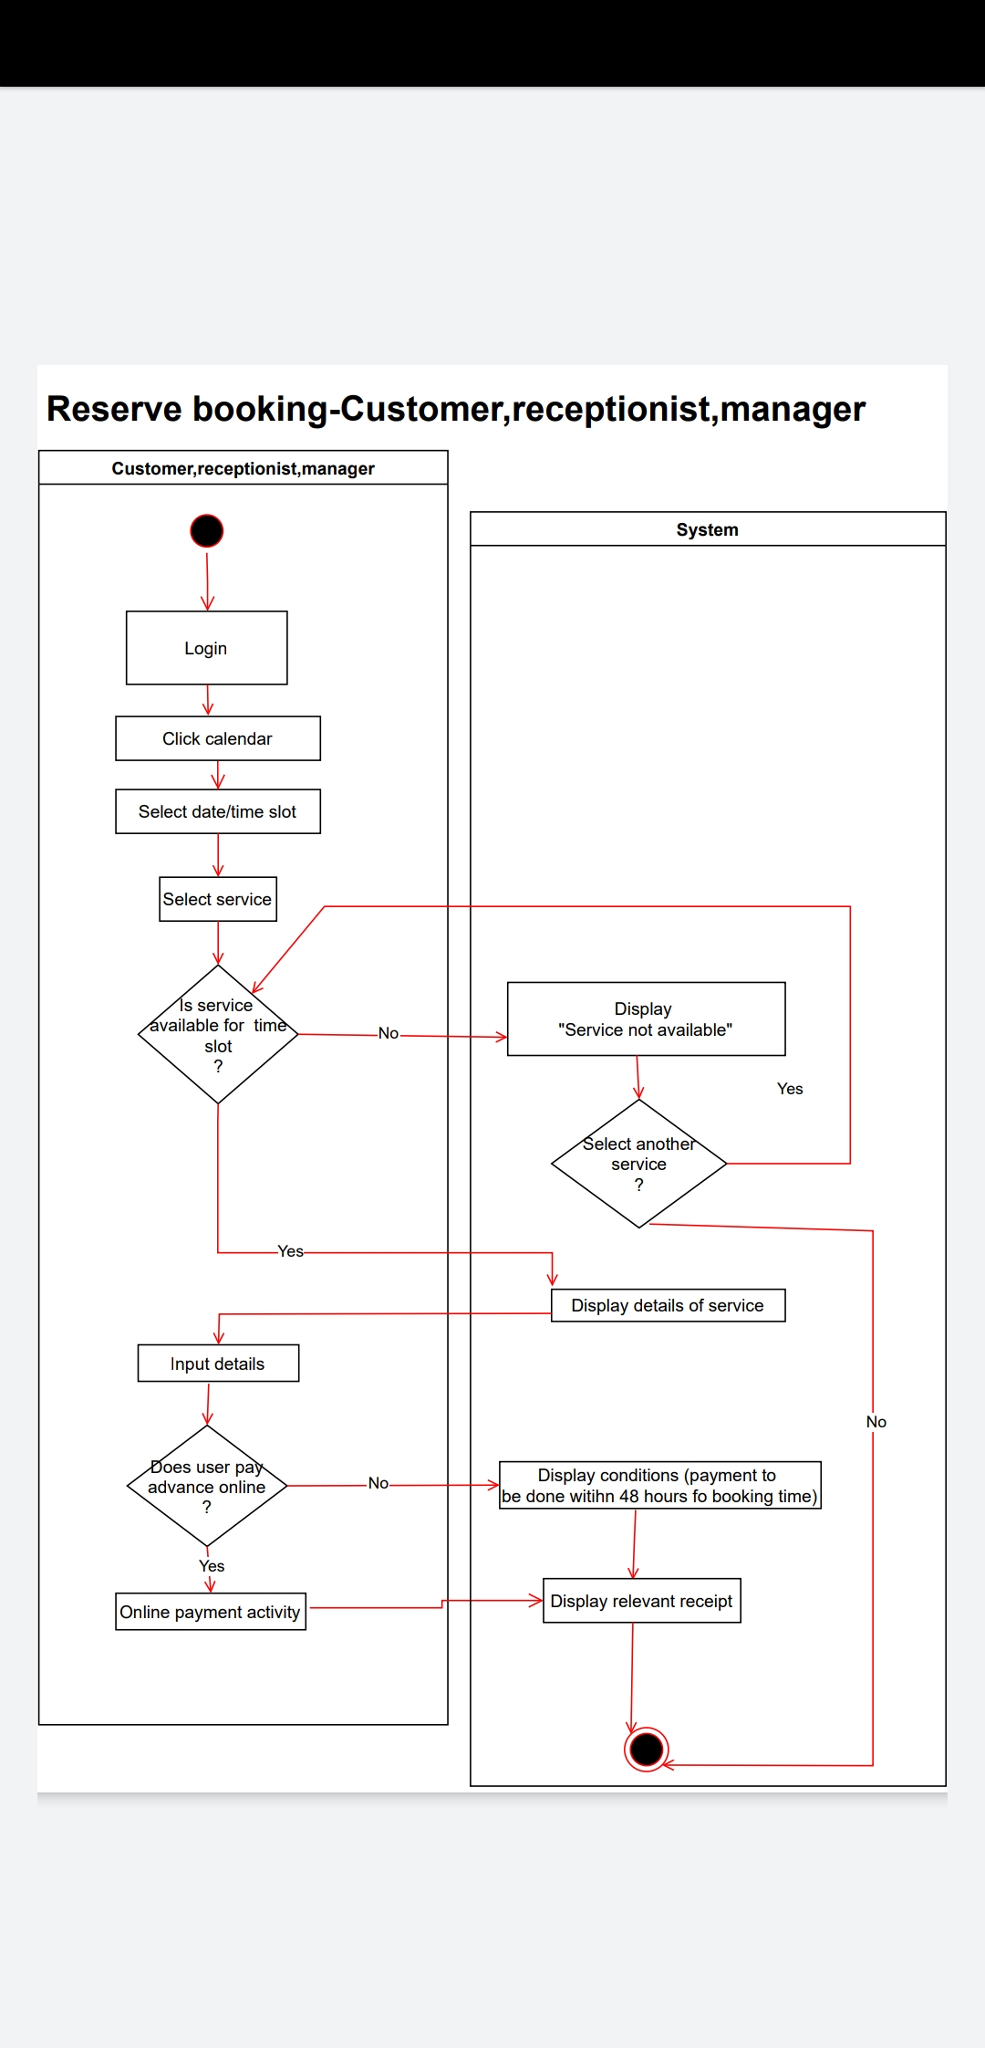

Slide 54
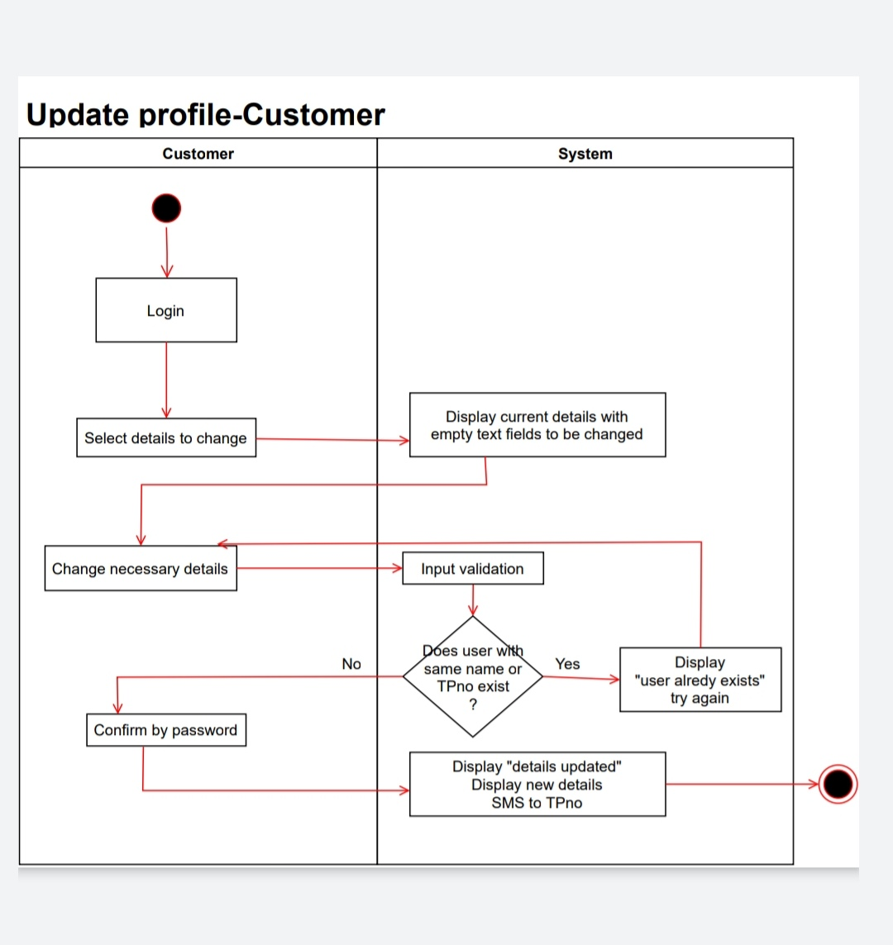

Slide 55
